Slide 1

Data Science Regression Trees
Facultad de Ciencias Económicas
Catedrático: Franz Haidacher

Slide 2
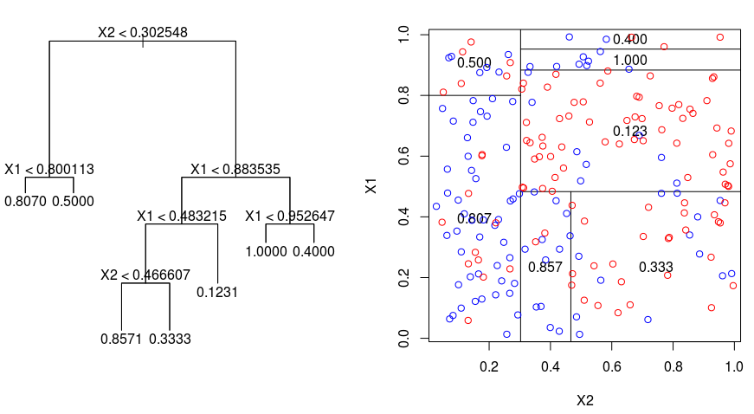
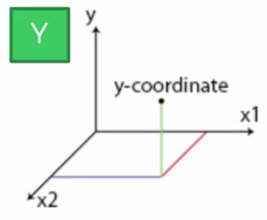
Regression Tree Intuition
Yes
No
Yes
No
Yes
No
Yes
Yes
No
Yes

Slide 3
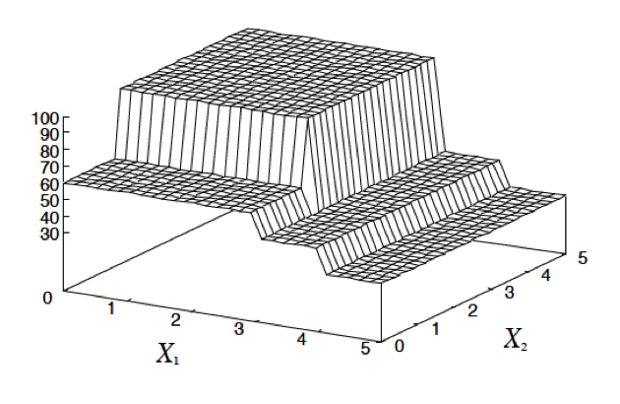
Regression Tree Result

Slide 4
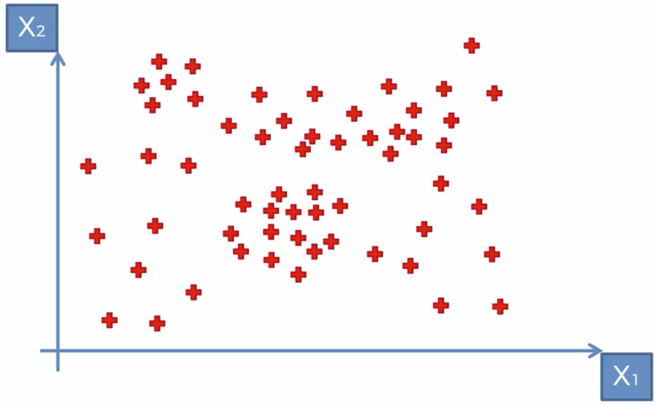
Where to split the data?

